Slide 1
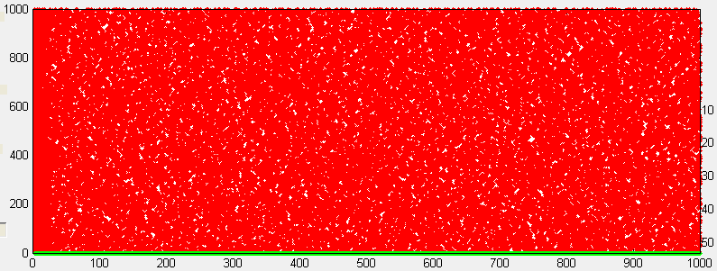
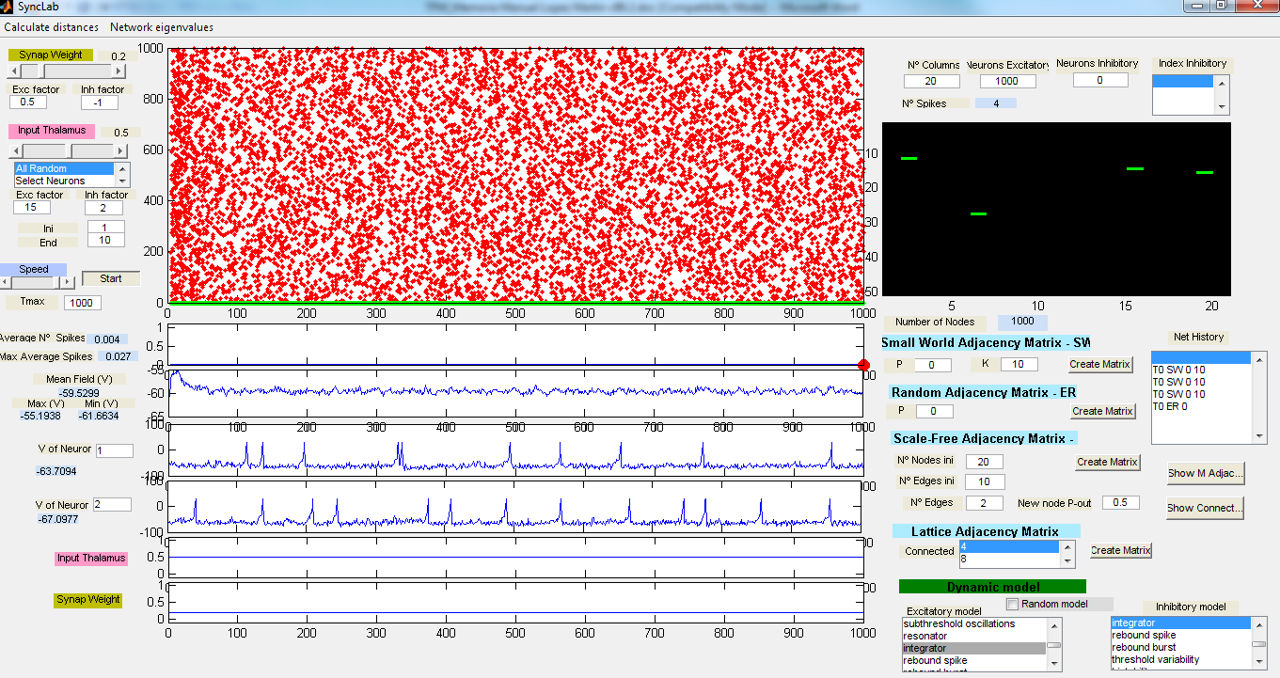

Slide 2
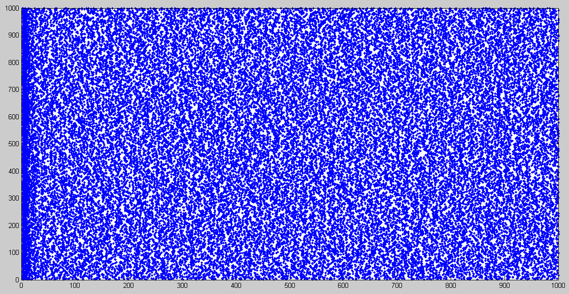

Slide 3
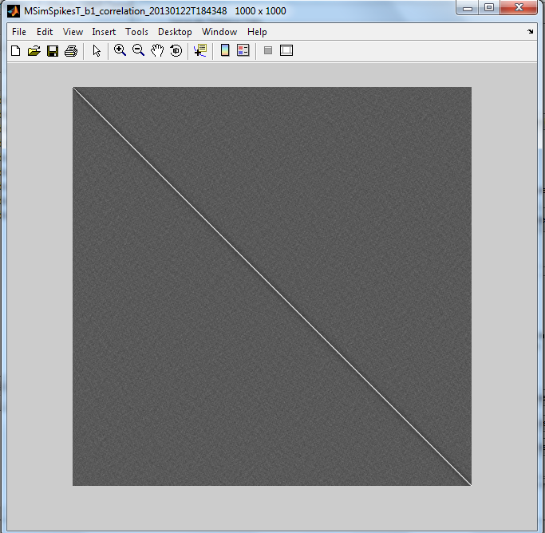

Slide 4
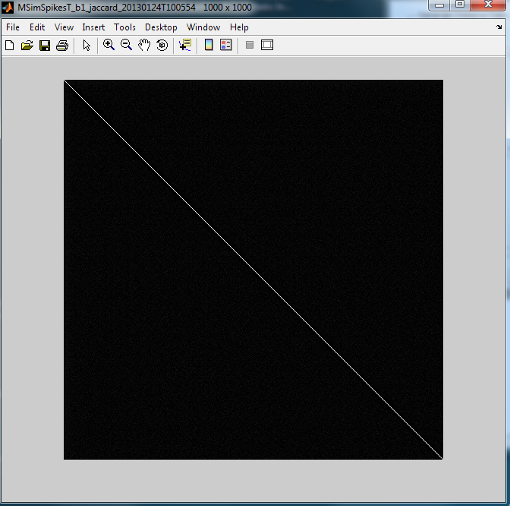

Slide 5


VV
Phase multivariate entropy of phase distribution
BUENA

Slide 6


VV Transposed
Phase multivariate entropy of phase distribution
BUENA

Slide 7
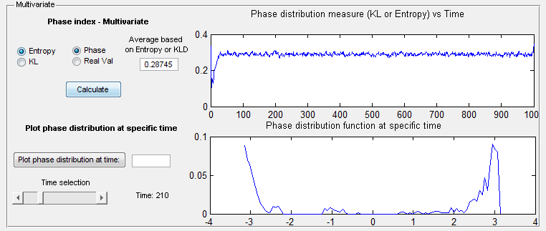
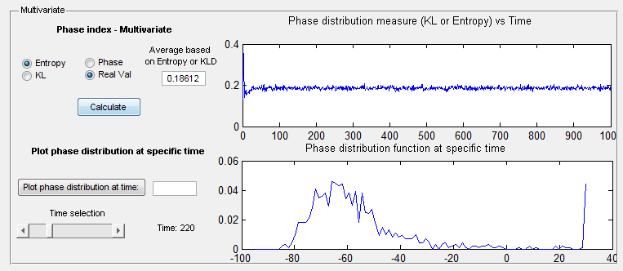
VV
Phase multivariate entropy of phase distribution

Slide 8
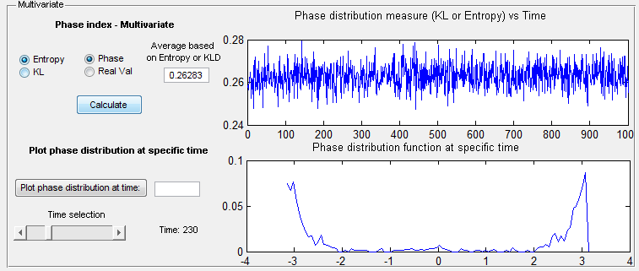
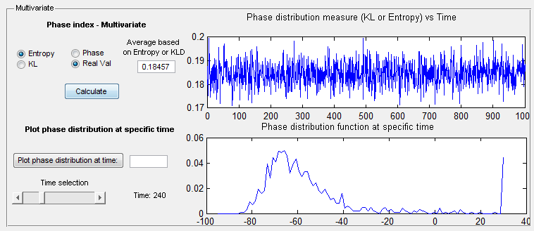
VV Transposed
Phase multivariate entropy of phase distribution

